Slide 1
Aung San Suu Kyi

Slide 2
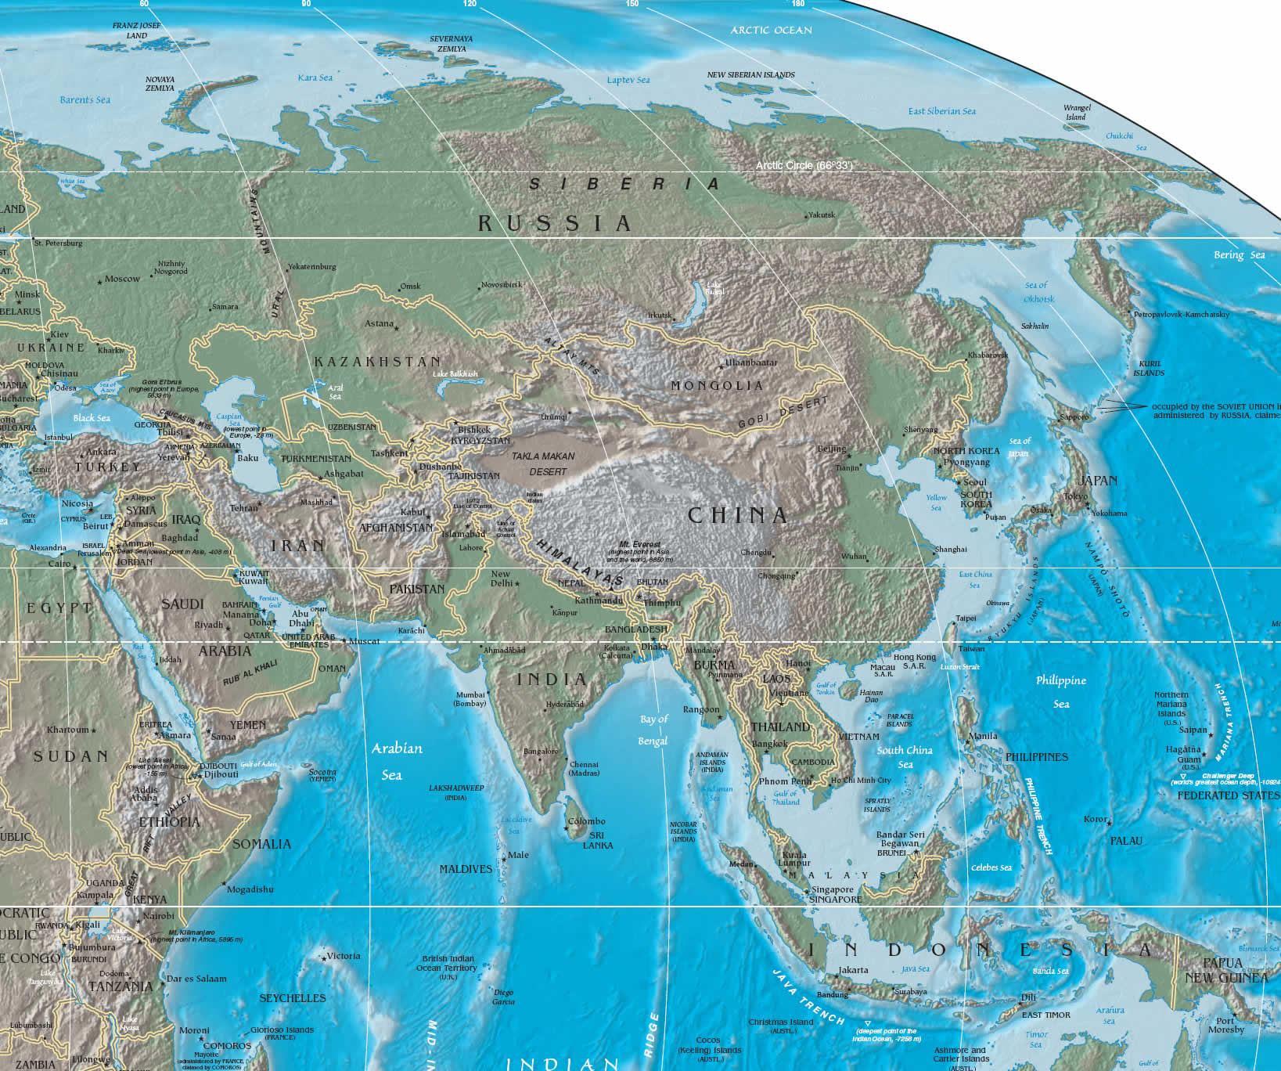
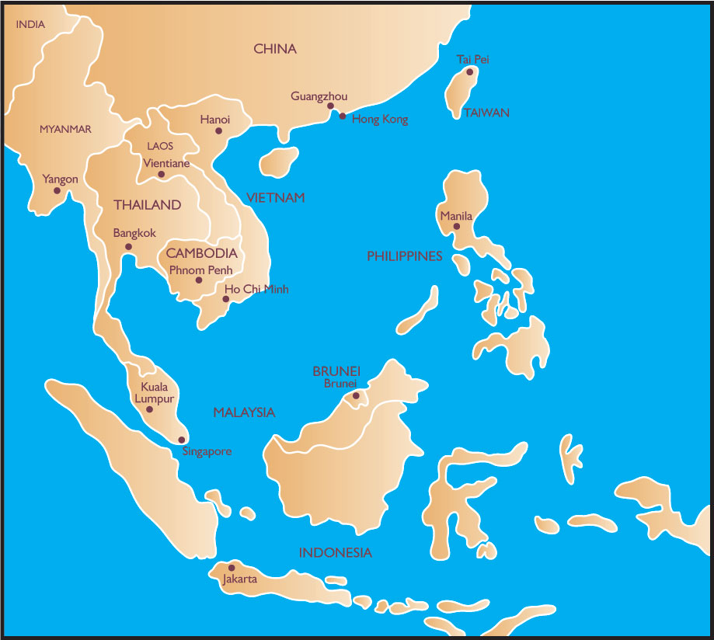
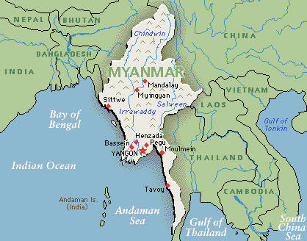
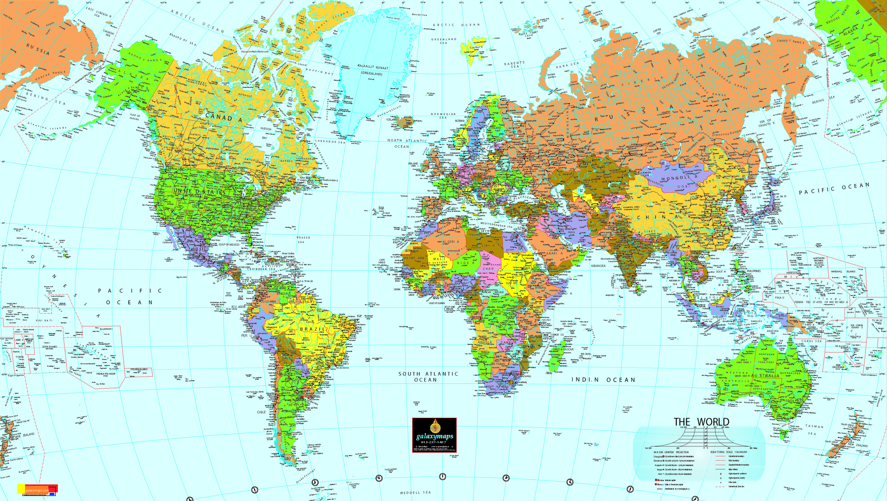
Do you know about Miyanmar?
Where is Myanmar?
Burma? Myanmar?

Slide 3
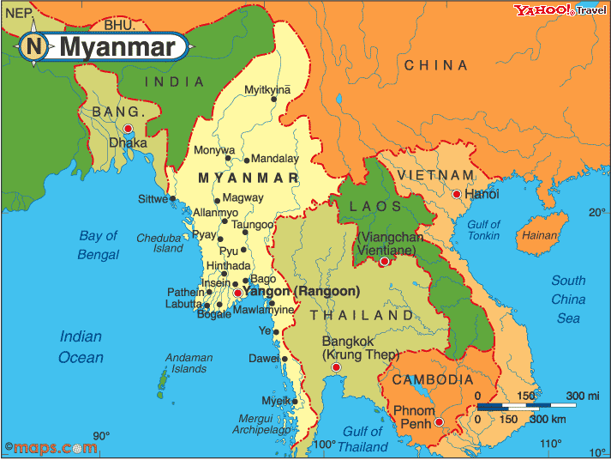
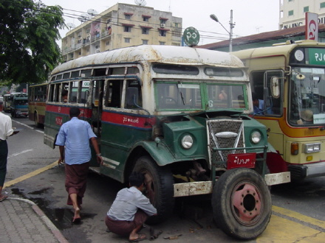
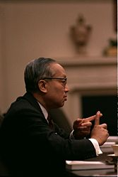
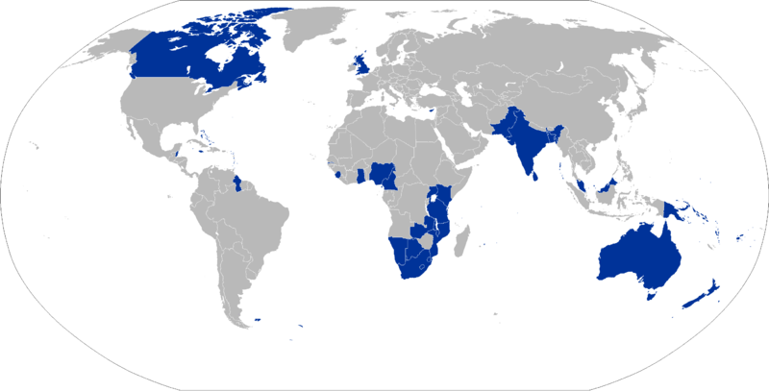
History of Myanmar
Independent from the U.K (4 Jan, 1948).
Democratic period
Military dictatorship
8888 uprising
1990 despite of result of election…
Move capital
Oct 13, 2007

Slide 4
Who is she ?
Aung San Suu Kyi
Notes:
Hi everyone- I will talking about Aung San Suu Kyi.
Do you have any idea about her?

Slide 5
Who is she ?
Pro-democracy campaigner
Leader of the opposition National League for Democracy (NLD)
House arrest for 18 years
Notes:
Yes. She is protester. She opposed the military government for their freedom.
She also leader of the opposition National League for Democracy.
That is why, she was house arrested by military government for 18 years.
During arrest she has chance for leave her country. For example, when her husband died or when she won
Nobel peace Prize. But she didn`t. Because she know if she leave her country, she can not back home.
Now i will show some video about her.

Slide 6
What did she do ?
Nobel Peace Prize 1991
NLD won the national election in May 1990 for freedom
Notes:
As you watch video, she won Nobel peace prize. And 영환 also already told that NLD which is her group
Won the national election.
And she succeed to attract people`s attraction.
So everybody support her.

Slide 7
But Nothing Change
How come ?
Notes:
But noting change. They still fighting. They still have no freedom.
How come?

Slide 8
Good job ! Aung San Suu Kyi
But it`s not our business -
Many government and international company are still good business partner with Burma`s military regime
Notes:
Because people do like this.
“good job. Aung San Suu Kyi. But it`s not our business.”
I mean ,Can you remember video?
In middle of video, they talking about Chevron. “ Don`t support Chevron”
Chevron is big oil company. They are good business partner with Burma`s military regime.
That is why, military government still has power. The government has a lot of friends in the world.
They just care money. Because Myanma is good market for making money.
If you want Myanma`s freedom, you have to take out military govornment`s power.

Slide 9
Show your support Try to change
www.actionburma.com
Notes:
so, here is your job!
She did good job it was very nice. and she still working.
This time is our turn. We have to show our support.
Monitoring your government and your country company.
If they want to make a contract with Burma military regime for just money, you have to make stop.
It will deprive their power and money.
Deva always told that “it is human being. It is our world. It is not their world.”
Don`t forget do something!!!!

Slide 10
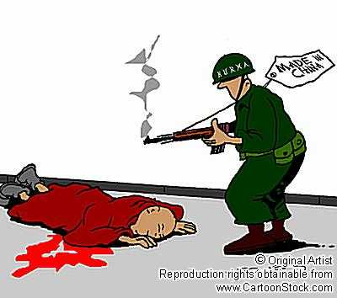
Opinion

Slide 11
Reference
http://www.birmanie.net/
http://www.actionburma.com
http:/www.youtube.com
http://de.wikipedia.org/wiki/Aung_San_Suu_Kyi

